Slide 1
AllVue
Cheap, automated, customisable deployment of live dashboards and on-demand data feeds for any set of surveys

Slide 2
But first... a quick overview of work on the go
About half a dozen MyVue deliveries
Web feedback
Social/app feeds
Head office view
Responsive site
SSO
…
WGSN Barometer (Ladieswear)
Additional measures
Support for text measures
(Plus all that reporting work I said we were going to do on the roadmap)
WGSN Barometer (Menswear)
Eating Out
Aspen tracker & survey dashboards (our first AllVue testbed)
AllVue

Slide 3
AllVue: Target Markets/Users
Market research agencies
Consultants
Insight directors/managers
Others (e.g., C-level, other buyers and stakeholders)
More info at: https://app.clubhouse.io/mig-global/epic/8093/all-vue-on-demand-export-of-response-level-data-in-various-formats

Slide 4
AllVue: Scope
Automated, on-demand, dashboard deployment
On-demand data/feed download in various formats
Support for feeds other than the survey platform database
A vague cross-tabbing requirement

Slide 5
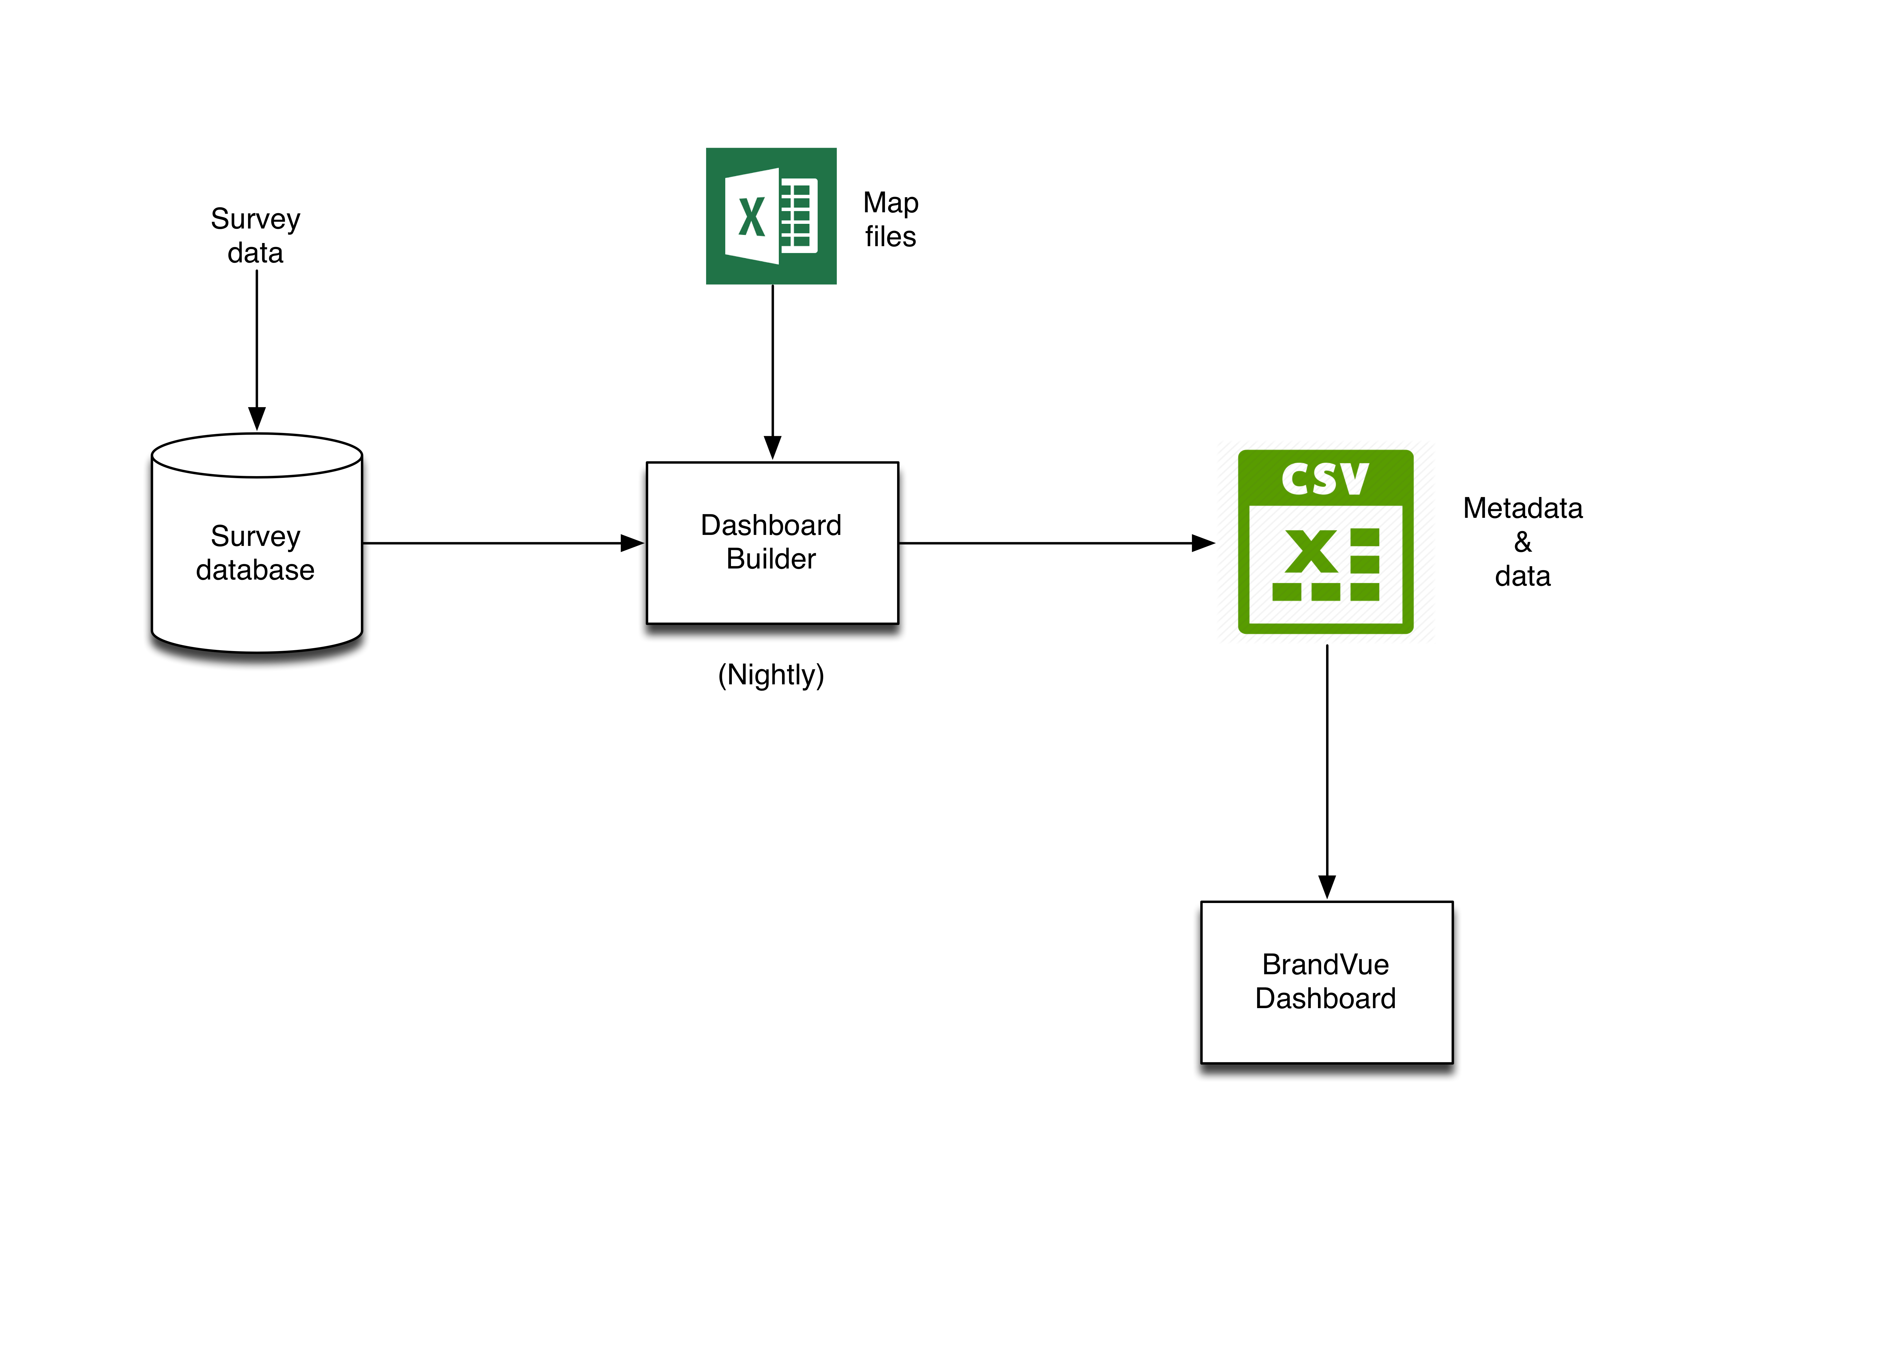
AllVue: Where are we now? (BrandVue)

Slide 6
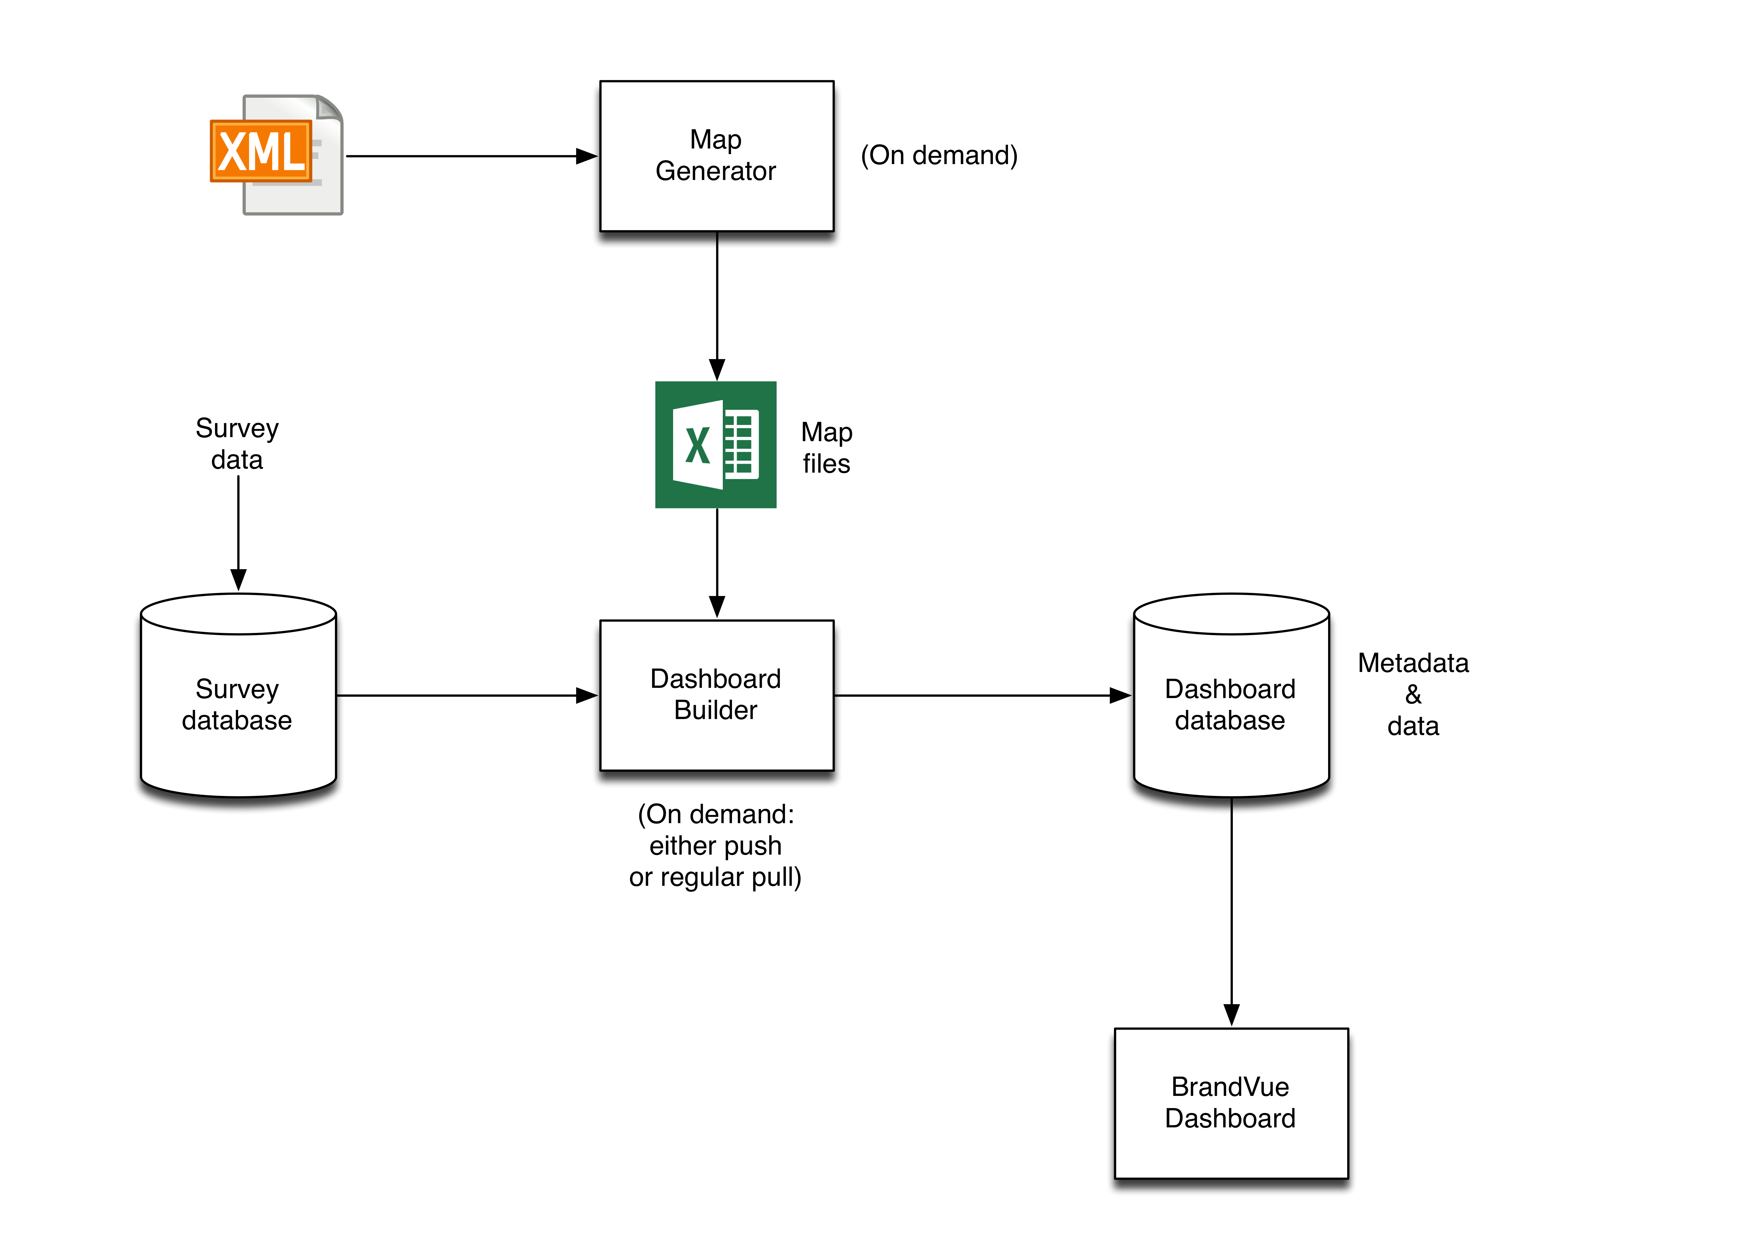

AllVue: Where do we need to be?
Survey MQML
definitions
Ahem… AllVue

Slide 7
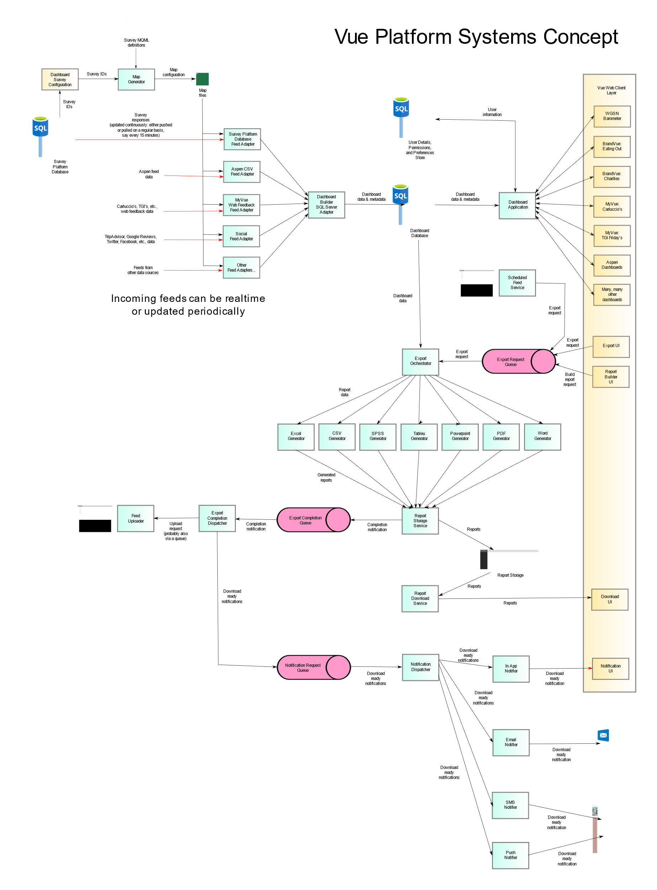
AllVue: Where do we REALLY need to be?
Diagram available at https://github.com/MIG-Global/BrandVue/blob/master/doc/AllVue/AllVueSystemConcept.svg

Slide 8
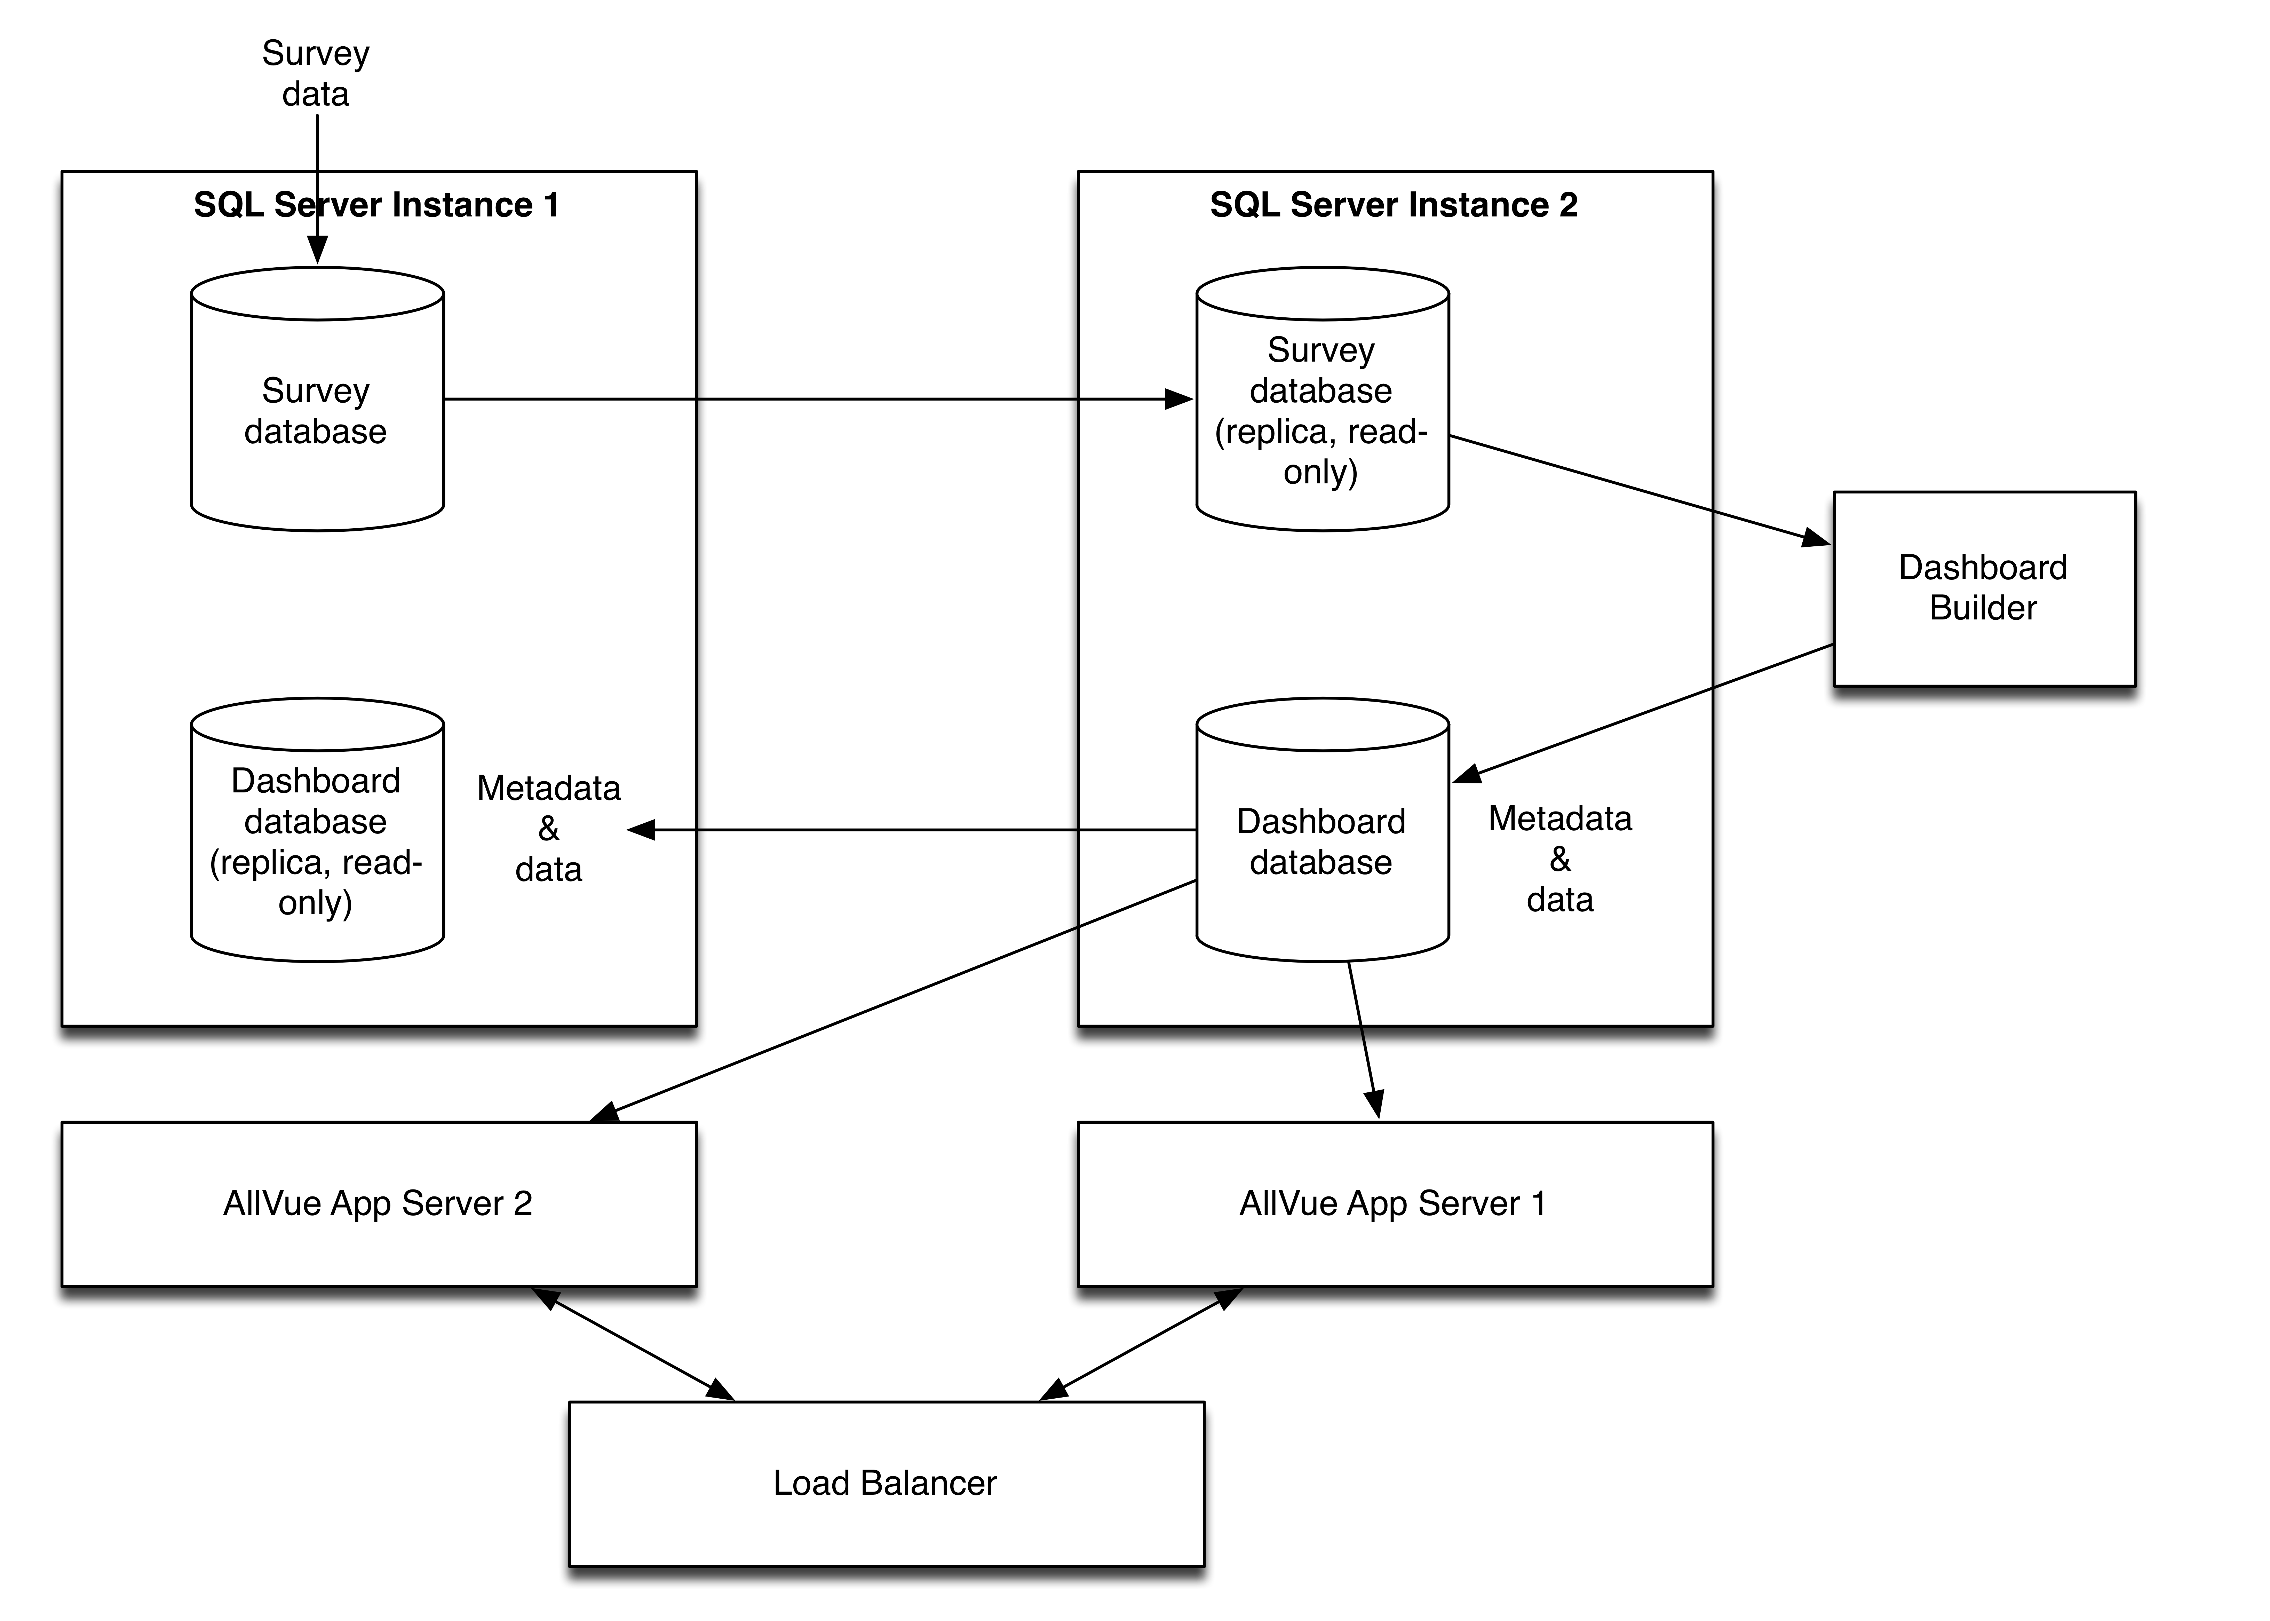
AllVue: Infrastructure & databases

Slide 9
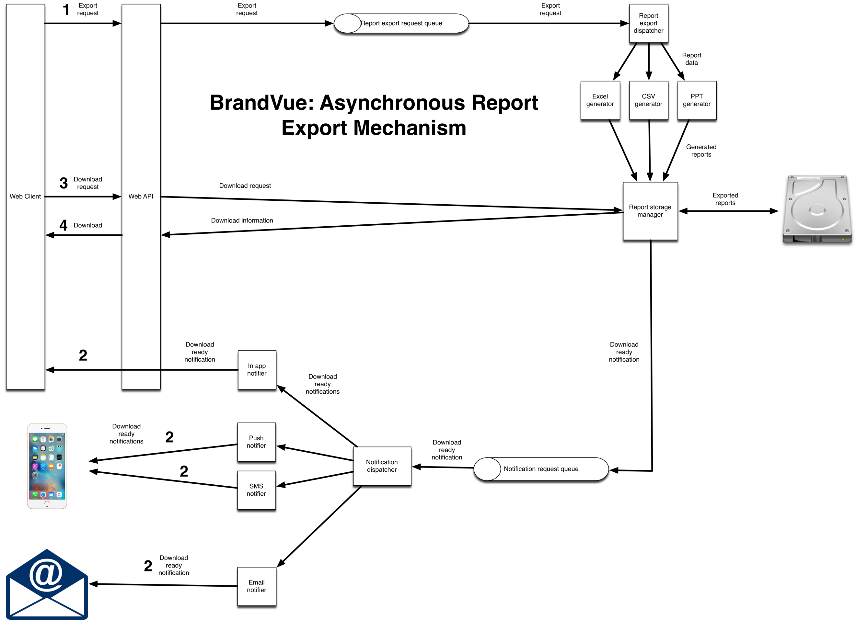

Slide 10
AllVue: Prototype
Generate map files automatically
Dashboards generated by overnight build process

Slide 11
AllVue: MVP
Data from survey database in real-time (ish)
Dashboards generated on demand

Slide 12
AllVue: Beyond MVP
On demand export/feed download
Greater customisation of map and UI by consultants
Measure definition language
User customisable dashboards
Advanced reporting
GPU based measure calculation
AI and machine learning
That cross-tabbing thing

Slide 13
AllVue: Beyond MVP
Map file customisation (without overwriting on regeneration)
Dashboard appearance customisation (colours, logos)?

